Slide 1



E-Learning website
By : Jayant Parihar (BCA III Year)

Slide 2
INTRODUCTION
CodeHub is an innovative website that provides a comprehensive platform for coders to learn various programming languages, including HTML, CSS, JS, Java, Python, C, C++ and PHP. One of the standout features of CodeHub is its live code editor and its Best Programming Courses , which offer a hands-on and interactive learning experience.

Slide 3
Overview
Launching an Online Programming Tutorial Website for Students , Coders and Developers. With CodeHub's Interactive Learning Platform.

Slide 4
Objective
The objective of this presentation is to highlight how CodeHub's live code editor and programming Courses have transformed the way coders learn and enhance their coding skills.

Slide 5
Technologies Used
HTML (HyperText Markup Language): - Use HTML to structure the content of your website, such as creating headings, paragraphs, lists, and links. - Build the layout of your web pages by organizing content into sections and div. - Embed images, videos, and other multimedia elements using HTML tags. - Create forms to collect user input, such as login/signup forms, search bars, and contact forms.
CSS (Cascading Style Sheets):- Apply CSS styles to enhance the visual appearance of your website, including fonts, colors, layout, and responsiveness. - Implement responsive design techniques to ensure your website looks and functions well on various devices and screen sizes. - Style buttons, navigation menus, and other UI elements to create an engaging user experience.
JavaScript:- Use JavaScript to add interactivity and dynamic behavior to your website. - Implement features like interactive coding editors and real-time content updates. - Create pop-ups, modals, and tooltips to provide additional information to users. - Enable client-side validation for forms and user inputs.
PHP (Hypertext Preprocessor): - Develop the backend of your website using PHP to handle server-side operations. - Store user data and course progress in a database. - Implement user authentication and authorization for login/signup. - Create dynamic content by fetching data from the database and generating HTML output.
Bootstrap And Tailwind CSS : - Bootstrap to used to create structure of the panels , forms , tables. -Tailwind CSS is used to design the website -Tailwind is used to provide a user friendly Environment with its Enhanced Design.

Slide 6
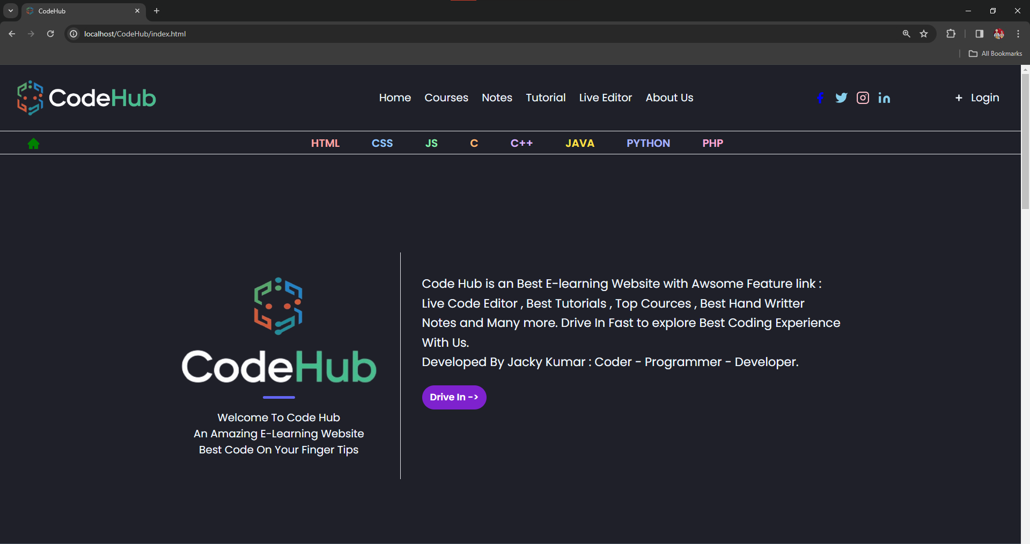
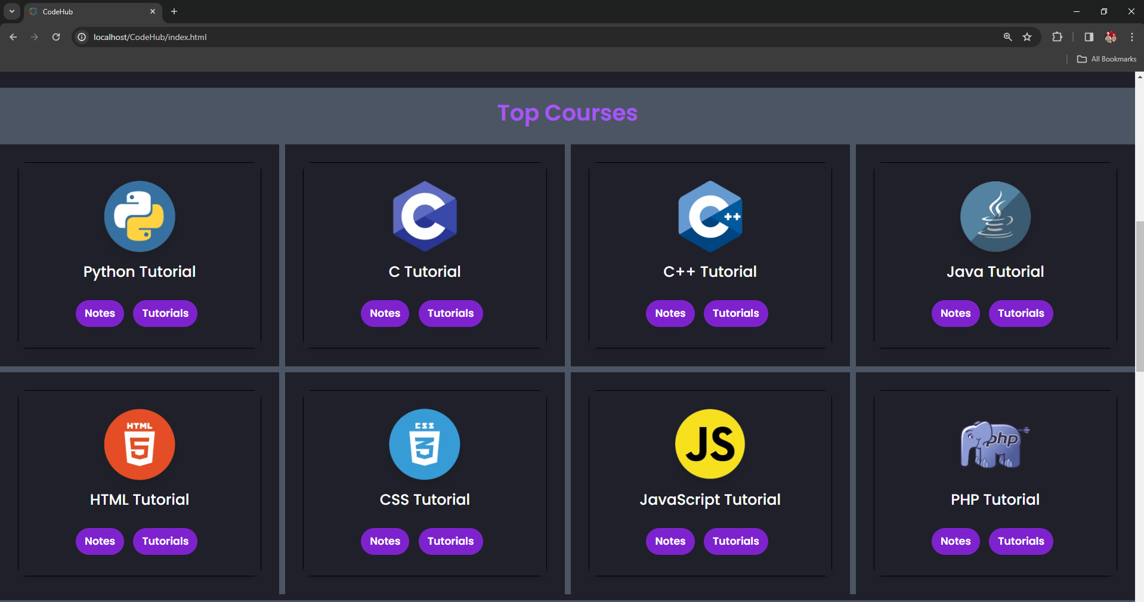
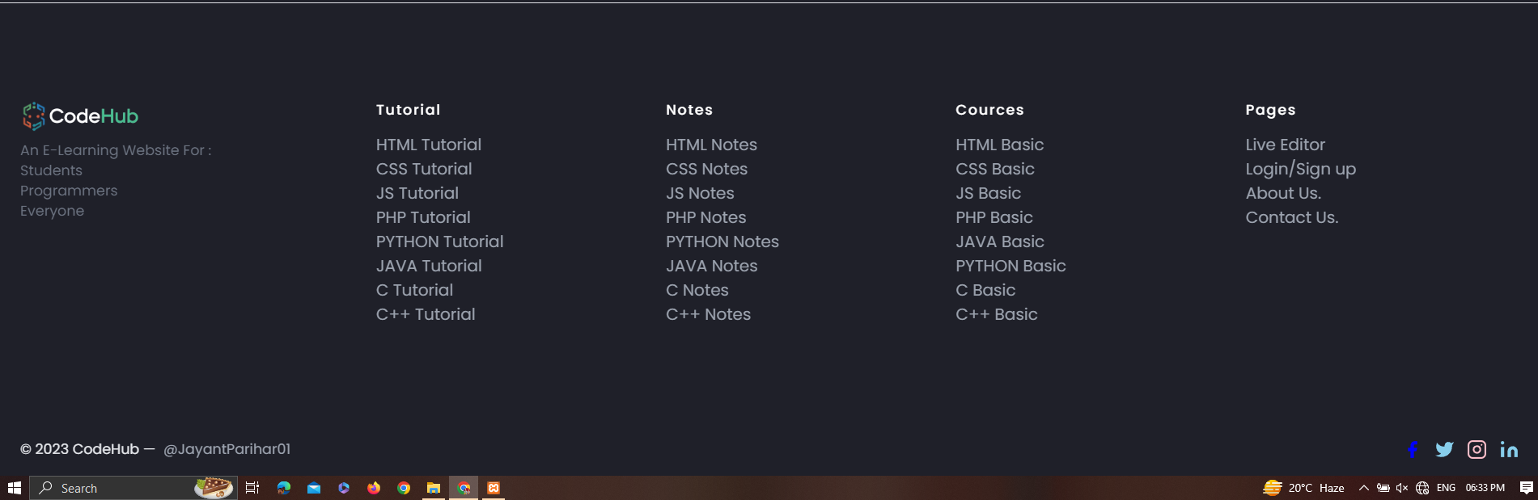
Home / Top Courses / Footer

Slide 7
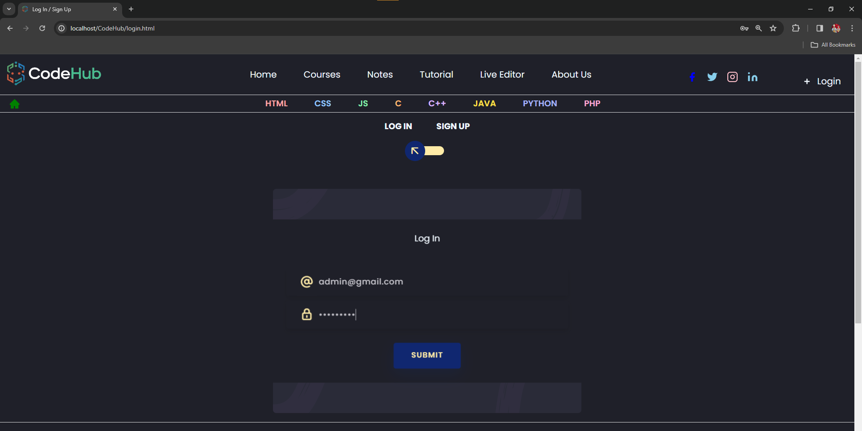
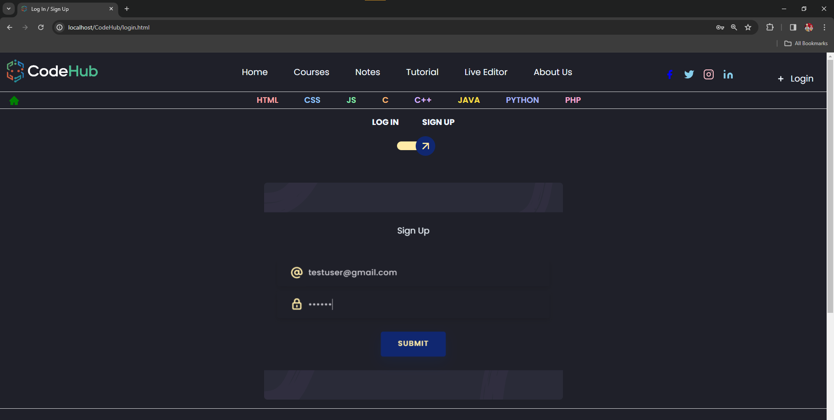
Login / Sign Up

Slide 8
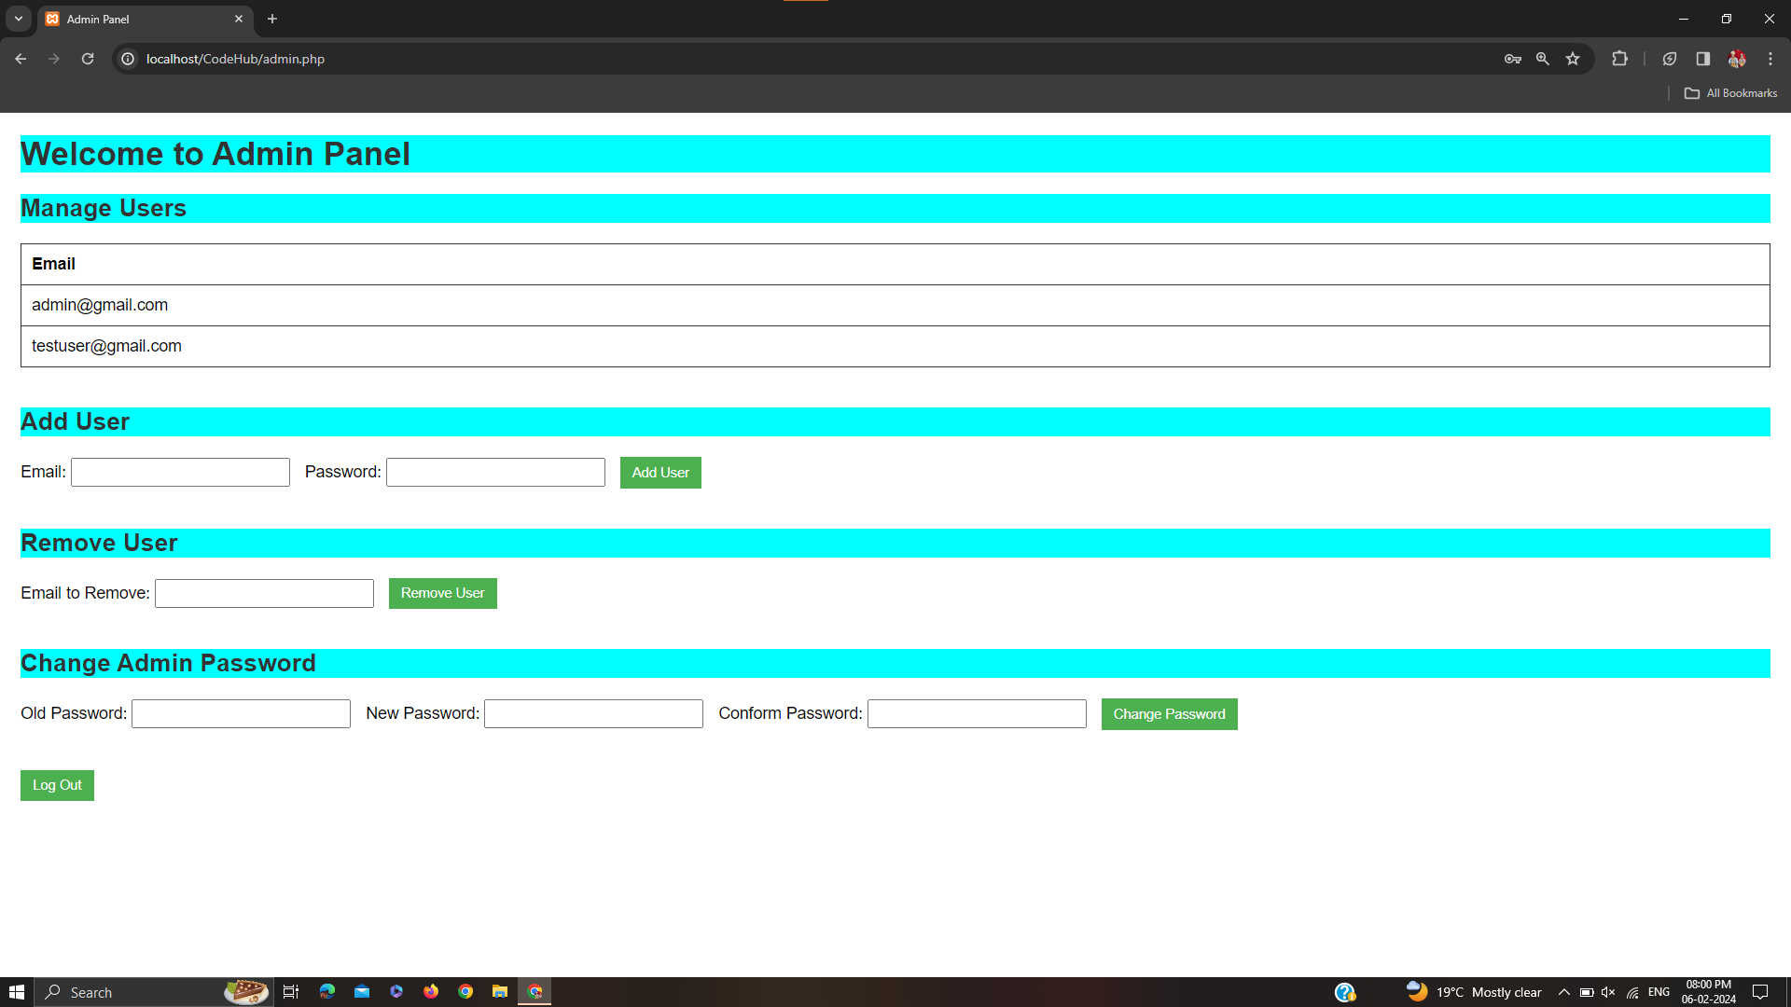
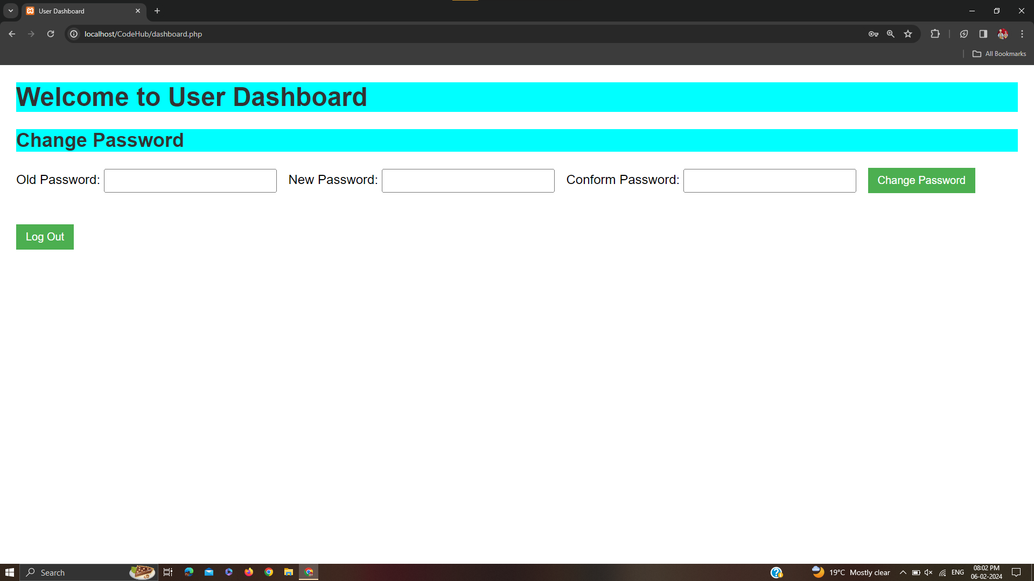
Admin Panel / User Dashboard

Slide 9
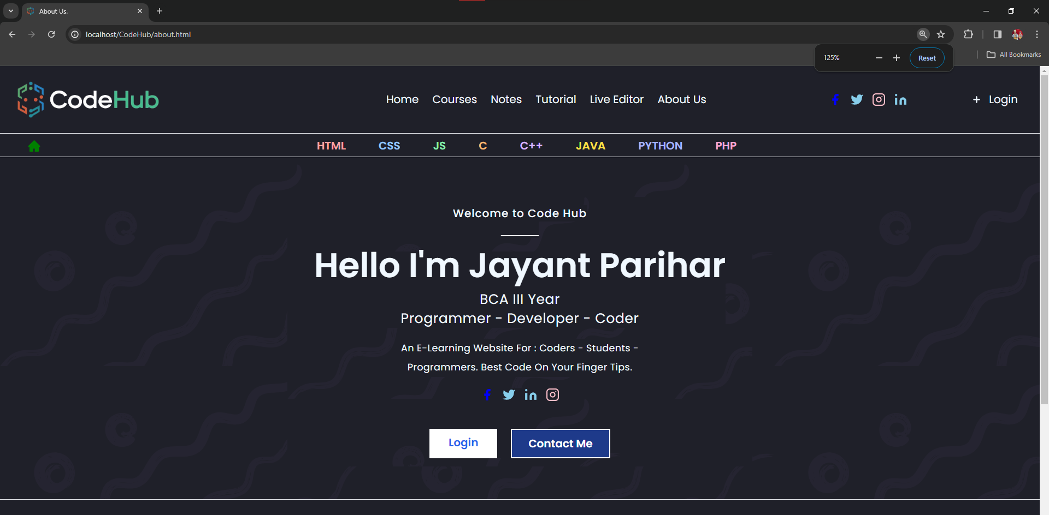
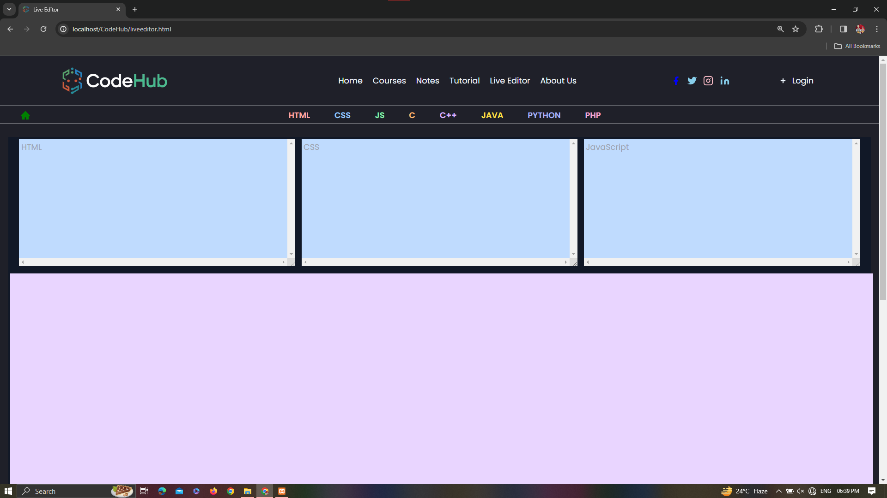
About Us / Live Code Editor

Slide 10
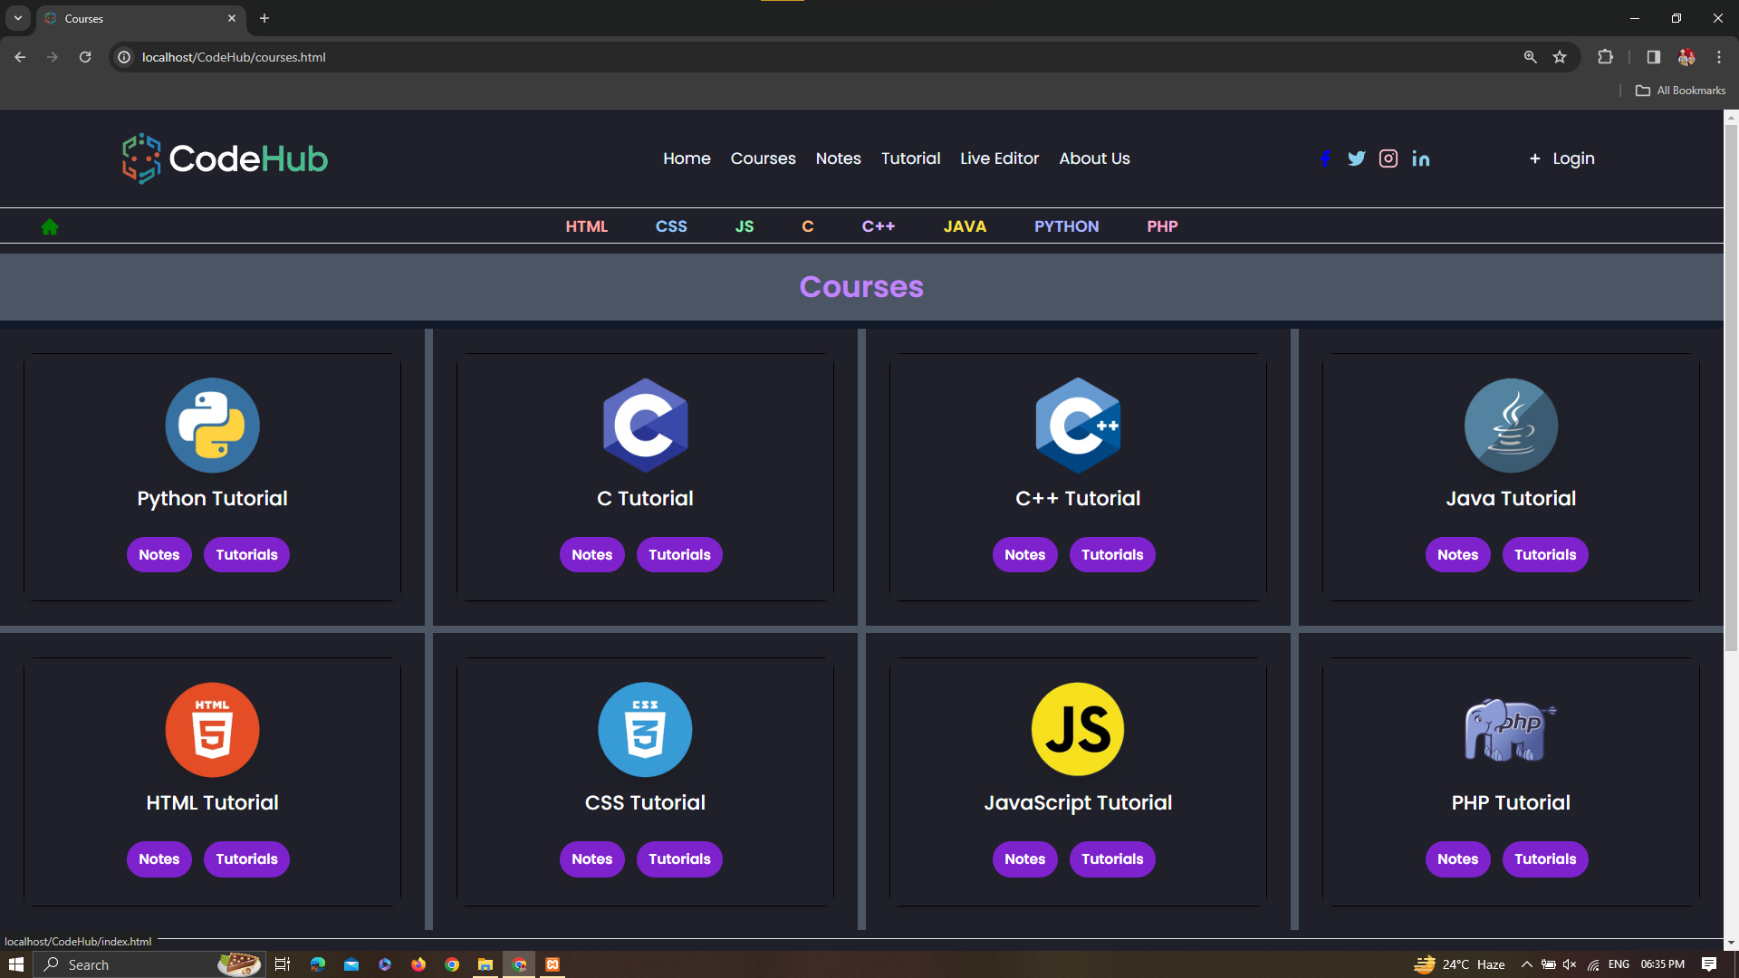
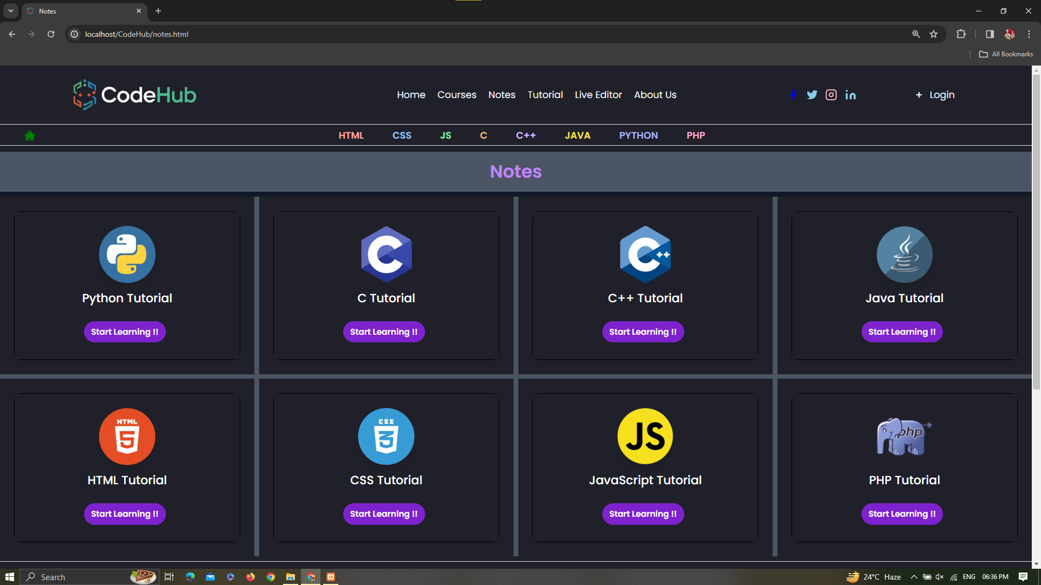
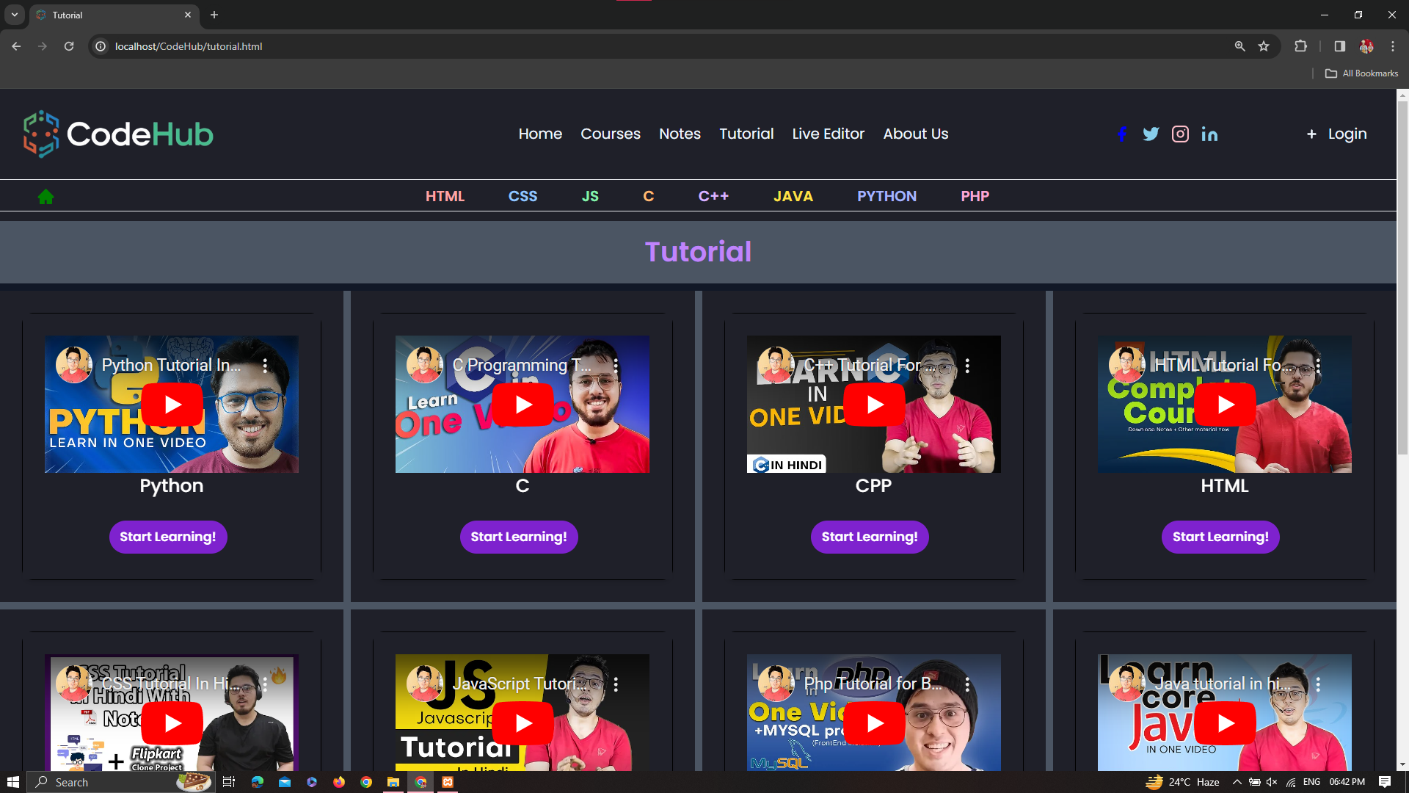
Courses / Notes / Tutorial

Slide 11
Conclusion
CodeHub's live code editor and programming Courses have revolutionized the learning experience for Coders , Programmers and Developers. By providing an interactive and practical platform, CodeHub has empowered coders to enhance their skills in various programming languages. The Live Code Editor , Tutorials and Courses that have made CodeHub a go-to resource for aspiring coders.
By combining these technologies, we can create a feature-rich online programming tutorial website that offers interactive lessons, coding exercises, and user profiles.

Slide 12
THANK YOU
Presented By: Jayant Parihar
BCA III Year

